Slide 1

Example of real tweet, redacted. Note the reach!
…and hundreds of comments

Slide 2
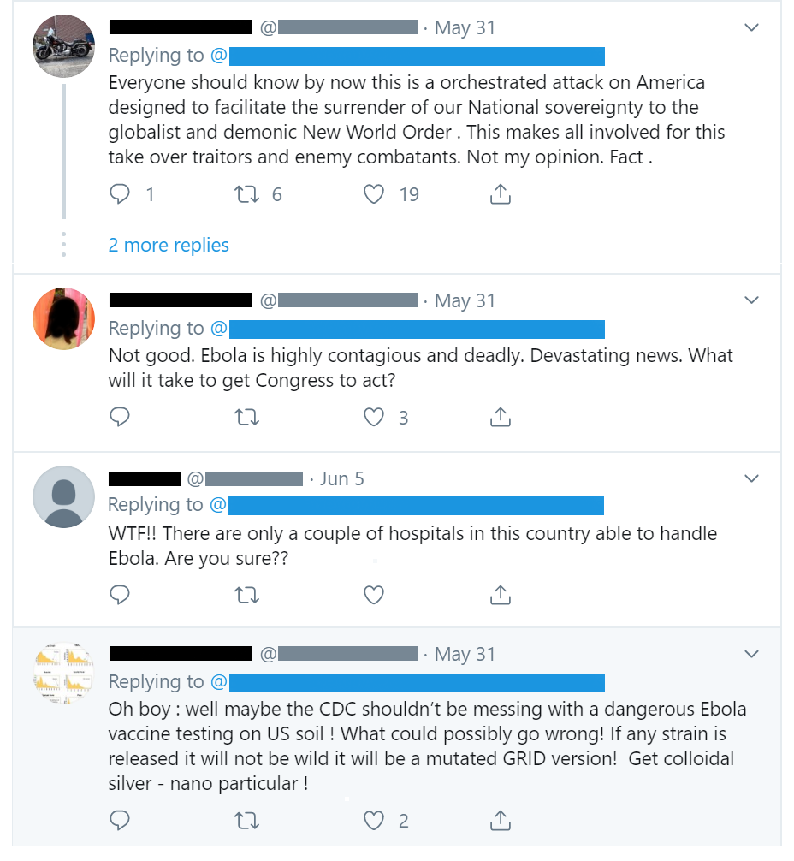
Select comments, redacted.

Slide 3

Select comments, redacted.

Slide 4
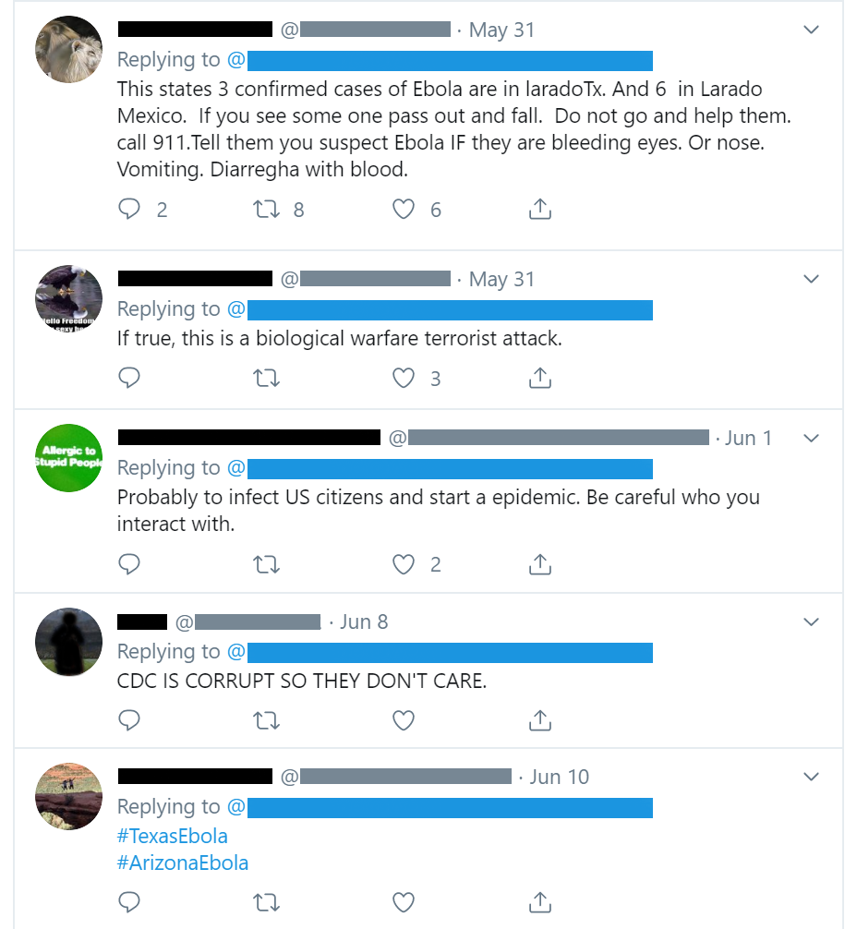
Select comments, redacted.

Slide 5




