Slide 1

SCHC 2019 HCID Tabletop Exercise
November 15, 2019 ▪ 12:30pm – 3:00pm (CST)
Country Inn & Suites ▪ Mankato, MN

Slide 2

Overview of Exercise
“Situation Manual” in your handbooks
Tabletop Exercise Format
  No-fault, low-stress
  Do not fight the scenario
  Rely only on current capabilities
Two Modules (50 min each; provided at time)
  Scenario Updates
  Questions for Discussion

Slide 3
Overview of Exercise
Exercise Roles
  Lead Facilitator: present scenario
  Table Facilitators: lead discussion
  Table Scribes: record information
  Floating Evaluators: record information
  Players: participate in discussion

Slide 4
Overview of Exercise
Exercise Objectives: abilities to effectively…
  Share resources and work together
  Share information with the public

Slide 5

Overview of Exercise
Value of Exercise
  Gap Analysis
  Continuous Quality Improvement
  Your Coalition –
  Your Communities – [your county]
  Your Organizations – [your hospital/clinic]

Slide 6
Overview of Exercise
Scribes to complete…
  Scribe Logs (during discussions)
  Group Feedback Form (during hot wash)
Facilitators, please now…
  Identify your table’s scribe
  Provide them the Scribe Log

Slide 7
Overview of Exercise
Scribes, please be sure to…
  Record your table number on the log
  Record important information
  Turn in your forms after done

Slide 8

Let’s Begin

Slide 9
Module 1:
HCID Incident Management

Slide 10
Module 1
Staff:
Please distribute the Module 1 handouts
to the players at all tables now.

Slide 11
Module 1
August 2018 through October 2019
What soon mounted to become the world’s second largest Ebola epidemic on record, an Ebola outbreak was declared on August 1, 2018. Over the course of the remainder of 2018 and onward, through this October, the Democratic Republic of the Congo (DRC) continued to
grapple with the outbreak. By October 24, 2019, there were a total of 3,250 cases (3,133 confirmed and 117 probable), including 2,171 deaths, 1,045 survivors, and patients still under care at that time. Many countries around the world have lent resources and sought to control
the spread of this vicious disease through a variety of public health measures, including monitoring persons recently traveling to the region.

Slide 12
Module 1
November 5, 2019
American Paul Chapman has been working on a new business venture in Kinshasa, DRC for
the past six months. Aware of the outbreak, he has taken precautions to avoid sick persons while there, and feels well. His business is now done in Kinshasa, and he catches a flight home to Minneapolis (via Amsterdam), and drives home to his house in [your county].

Slide 13
Module 1
November 12, 2019
Today, Mr. Chapman presents in [your hospital/clinic] complaining of fever, fatigue, and diarrhea. During the screening process at intake, key travel questions are missed by staff. After 30 minutes in the busy waiting area, Mr. Chapman is examined and questioned clinicians. A stool sample is collected and tested by laboratory personnel; enteric pathogen panels are negative. Therefore, Mr. Chapman heads back home with instructions to treat what appears
to be a relatively low-risk ailment. He is cautioned to return if things get worse, however.

Slide 14
Module 1
November 13, 2019
After a rough workday, Mr. Chapman returns to [your hospital/clinic] late this afternoon
feeling much worse, and with new symptoms of a persistent fever of 103.6ºF (39.8ºC), chills,
and back pain. This time, the screening travel questions are caught at intake. When pressed about his personal activities, he finally admits that he had an amorous encounter with a local resident of Kinshasa the day before returning home to the US. He insists that his romantic…
cont’d…

Slide 15
Module 1
…partner seemed to be in good health, other than having a headache. Given his travel history, personal activities, and symptoms, Mr. Chapman is immediately placed in isolation. Prior to examining him, multiple nurses and a physician don PPE with assistance from fellow staff.
The attending physician consults with Infection Control. A blood specimen is collected and
sent to the State Laboratory. Two hours into the visit, Mr. Chapman begins to deteriorate. In coordination with Mayo Clinic Rochester, an Ebola-Ready transport unit is arranged to move
Mr. Chapman using an ISOPOD to Rochester for treatment; EMS receives the patient at
7:06pm, and he is successfully admitted in Rochester by 9:38pm.

Slide 16
Module 1
November 14, 2019
All staff members at [your hospital/clinic] who had contact with Mr. Chapman are instructed
not to report to work today, and their names are added to a tracking list to monitor their
wellness by phone. By midday, the State Laboratory confirms the presence of Ebola virus in
Mr. Chapman's blood specimen. Throughout the day, word spreads rampantly in the local
area and beyond about the mystery patient seen for Ebola. Rumors and misinformation begin
to mount and create panic in some people. As one example, the following tweet was posted to Twitter this afternoon with reference to [your hospital/clinic] : cont’d…

Slide 17
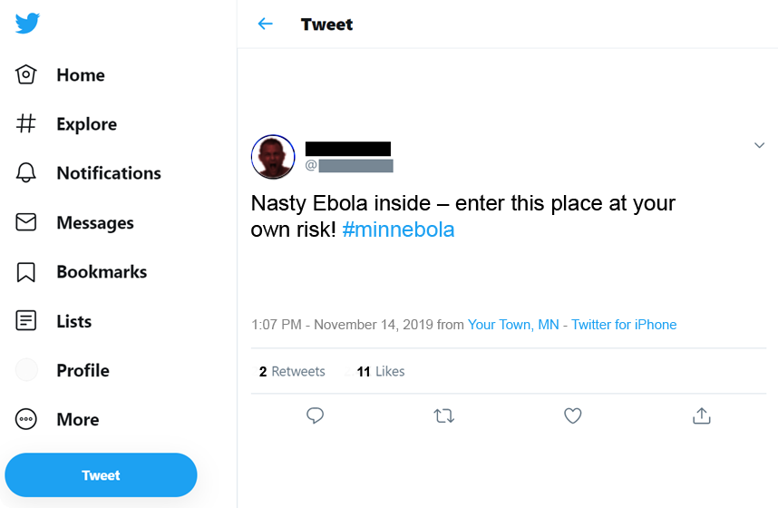
Module 1

Slide 18
Module 1
Access and Functional Needs
People with needs such as maintaining independence,
communication, transportation, supervision, and medical care.
People with disabilities, who live in institutional settings, elderly, children, limited English
proficiency, non-English-speaking, diverse cultures, and transportation disadvantaged.

Slide 19

Module 1
Discussion time
Use questions in Module 1
Reconvene at or before 1:35pm

Slide 20


Module 1
Discussion for this module concludes at or before 1:35pm

Slide 21

Module 1
5-minute
warning!
Discussion for this module concludes at or before 1:35pm

Slide 22

Module 1:
HCID Incident Management
END

Slide 23

Break Time!
Reconvene in 10 minutes

Slide 24

Module 2:
HCID Public Information

Slide 25
Module 2
Staff:
Please distribute the Module 2 handouts
to the players at all tables now.

Slide 26
Module 2
November 15, 2019
Today, at 10:39am, despite best efforts, Mr. Chapmen dies as a result of his illness at Mayo
Clinic Rochester. This update quickly circulates through the news and among private citizens. Additional rumors and misinformation about an alleged lack of infection control at [your hospital/clinic] have begun to take a toll, and area news agencies are requesting information about the steps taken to protect staff, patients, and local residents. By this afternoon, front desks, switchboards, and 911 are slammed with calls from concerned persons. Some are concerned that other local residents have been exposed. Yesterday’s damning tweet regarding to [your hospital/clinic] is now seeing explosive reach, as below: cont’d…

Slide 27

Module 2

Slide 28
Module 2
Discussion time
Use questions in Module 2
Reconvene at or before 2:35pm

Slide 29
Module 2
Discussion for this module concludes at or before 2:35pm

Slide 30
Module 2
5-minute
warning!
Discussion for this module concludes at or before 2:35pm

Slide 31
Module 2:
HCID Public Information
END

Slide 32

Hot Wash & Closing Remarks

Slide 33
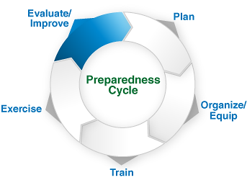
Hot Wash
“Why should we do this?”

Slide 34
Hot Wash
Major Takeaways
  Current strengths?
  Areas for improvement?
  Steps to get there?

Slide 35
Hot Wash
Group Feedback Forms (scribes complete & turn in)
  Basic Information (please indicate table #)
  Workshop Design
  Tabletop Exercise Design
  Strengths related to each objective
  Areas for Improvement related to each objective
  Additional Feedback on training & exercises

Slide 36

Closing Remarks

Slide 37

  On behalf of the South Central Healthcare Coalition,
  thank you for participating in today’s event!

